Slide 1
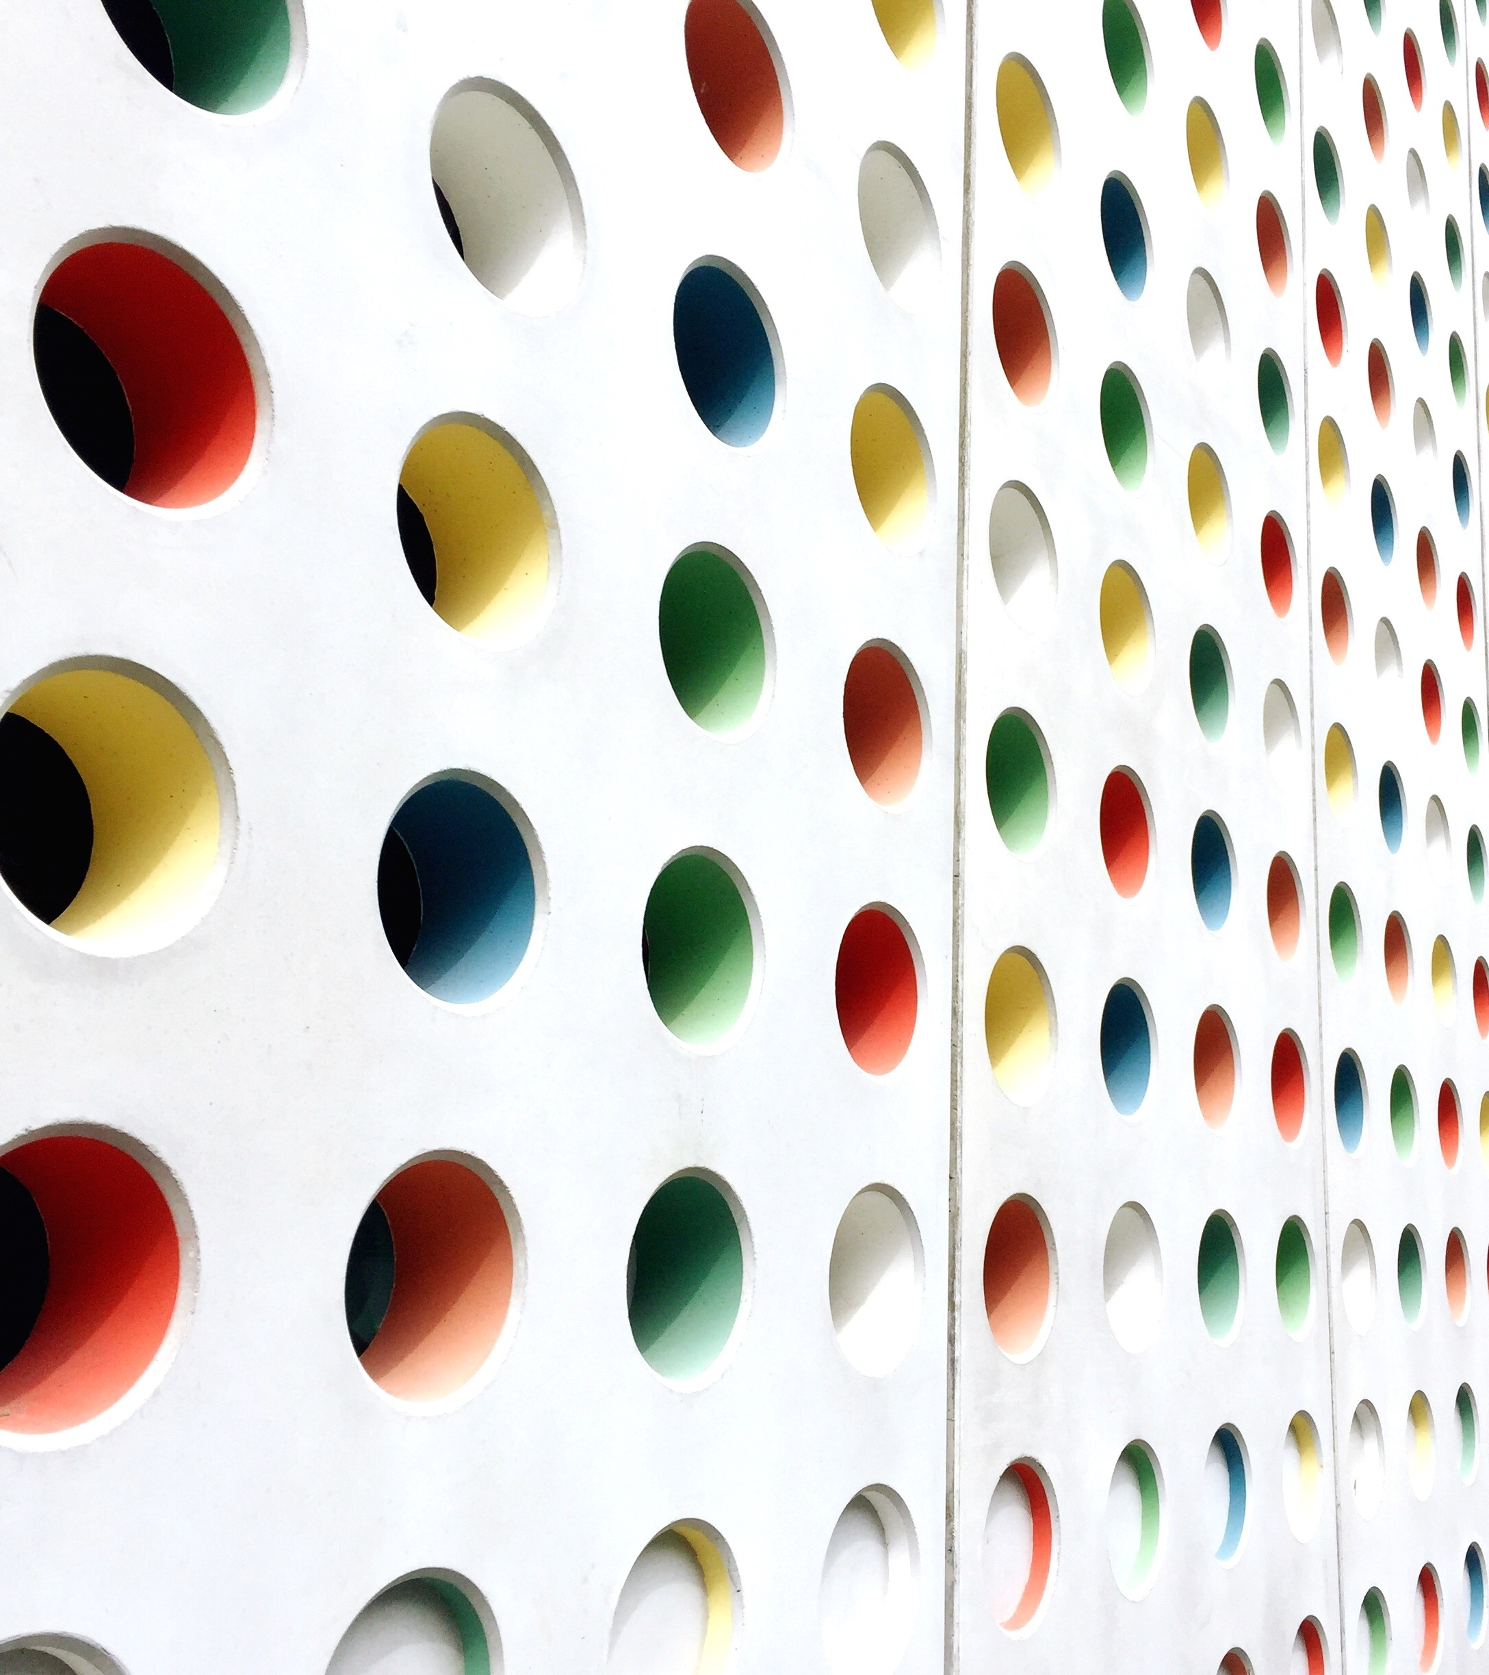
SMART HOME SYSTEM
KARTHIK Nair - AM.EN.U4AIE21138
R ARAVIND – AM.EN.U4AIE21151
VISHNU SHAJI – AM.EN.U4AIE21167
AKHILESH – AM.EN.U4AIE21108
MAMIDI SOWJI KRISHNA – AM.EM.U4AIE21181

Slide 2
INTRODUCTION
Smart Home is a collaboration of technology and services through a network for better quality living. A smart home allows the entire home to be automated and therefore provide ease and convenience to everyday activities in the home. This technology is used to make all electronic devices to act “smart”. Many people think this technology will reduce their workload, but smart home technology is combination of both. The research standards have already anticipated a smart, connected home where multiple devices cooperate to pamper to users wishes with little or no effort. But such straight forward home-wide tasks are remarkably unavailable from the mainstream even though the needed hardware devices are reasonably priced.

Slide 3
COMPONENTS REQUIRED
Arduino Uno R3
LCD 16 X 2
1kΩ Resistor
220Ω Resistor
Ultrasonic Distance Sensor
33.684, -434.259, -234.501 PIR Sensor
Gas Sensor
Photoresistor
Relay SPDT
Light bulb
DC Motor
5,5 Power Supply
Slideswitch

Slide 4
CIRCUIT DIAGRAM

Slide 5
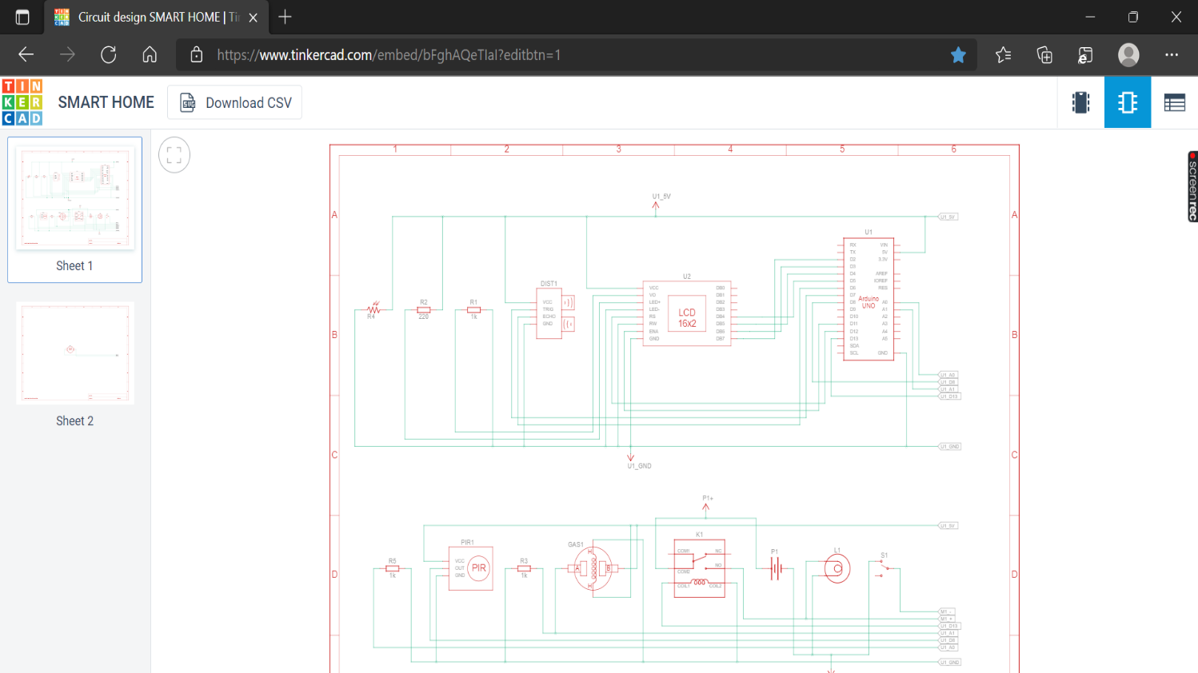

Slide 6
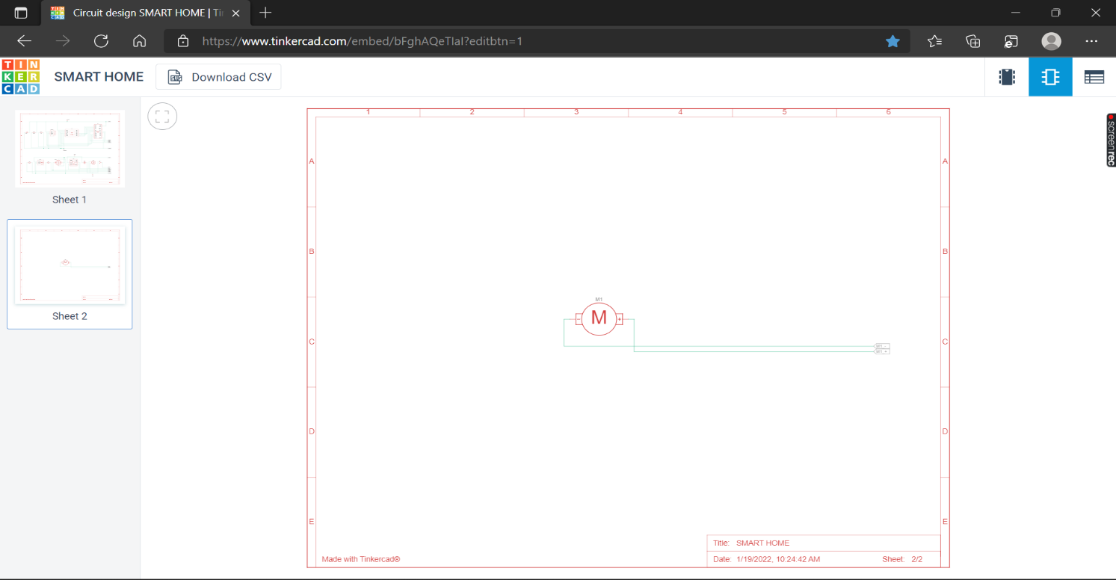

Slide 7
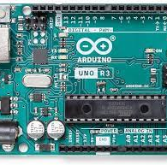
ARDUINO
The Arduino board is connected to a computer to a computer via USB, where it connects with the Arduino development environment (IDE). The user writes the Arduino code in IDE, then uploads it to the microcontroller which executes the code, interacting with inputs and outputs such as sensors, motors, and lights.

Slide 8
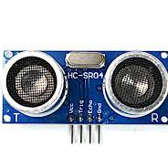
ULTRASONIC DISTANCE SENSOR
Ultrasonic sensors work by sending out a sound wave at a frequency above the range of human hearing. The sensor determines the distance to a target by measuring time lapses between the sending and receiving of the ultrasonic pulse.

Slide 9
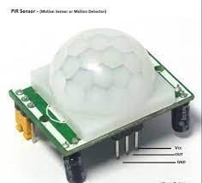
PIR SENSOR
Passive infrared (PIR) sensors use a pair of pyroelectric sensors to detect heat energy in the surrounding environment. These two sensors sit beside each other, and when the signal differential between the two sensors changes, the sensor will engage.

Slide 10
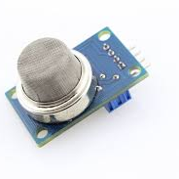
GAS SENSOR
Gas detectors use a sensor to measure the concentration of gases in the atmosphere. The sensor as a reference point and scale, producing a measurable electric current when a chemical reaction caused by a specific gas occurs.

Slide 11
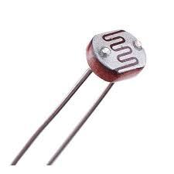
PHOTORESISTOR
When light is incident on the photoresistor, photons get absorbed by the semiconductor material. The energy from the photon gets absorbed by the electrons. When these electrons acquire sufficient energy to break the bond, they jump into the conduction band.

Slide 12
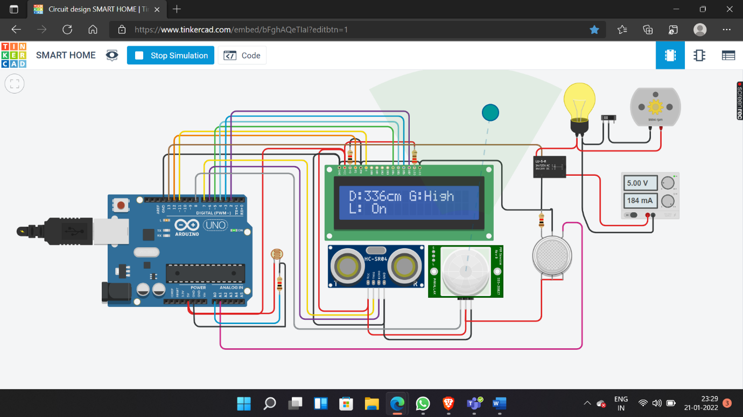
OUTPUT
Circuit design SMART HOME | Tinkercad

Slide 13
RESULT
When the system is activated, LCD displays messages according to the output from sensors and the light and fan is also turned on/off by the sensors outputs.

Slide 14
CONCLUSION
By using this home automation model, a normal house can be changed to a futuristic level. It can reduce the energy consumption, manual labour etc.
Also, there will be less chance for any short circuits.

